Slide 1
Mixed ANOVA
Lecture 18
Notes:
https://statistics.laerd.com/spss-tutorials/mixed-anova-using-spss-statistics.php#step3a

Slide 2
Keeping the stats straight
An independent samples t-test is used to determine if there are statistically significant differences between the means of two unrelated groups

Slide 3
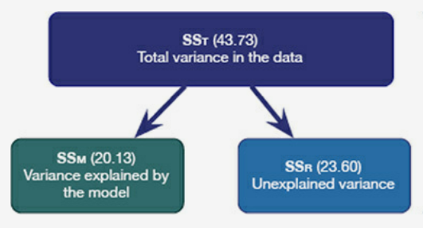
Keeping the stats straight
A one-way ANOVA is used to determine if there are statistically significant differences between the means of two or more unrelated groups
  It should be used with you data has one categorical IV with two or more levels and one continuous DV

Slide 4
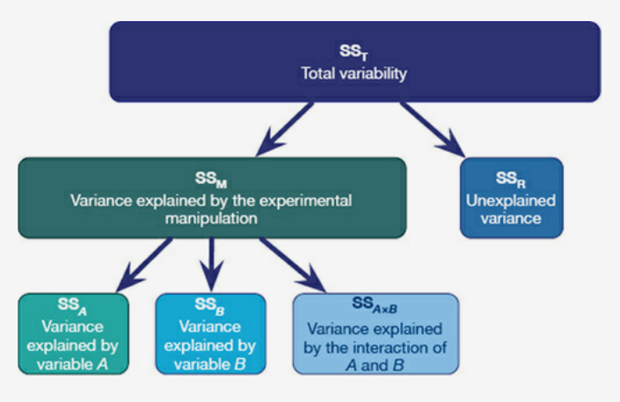
Keeping the stats straight
A two factor ANOVA is used to determine if there are statistically significant differences between the means of two or more groups
  It should be used when you data has two categorical IVs with two or more levels and one continuous DV
  It allows us to look for main effects and interactions

Slide 5
Keeping the stats straight
A within-subjects t-test is used to determine if there are statistically significant differences between the means of two related groups
  You should use a within-subjects t-test when your data has one independent, categorical variable that has two levels (or groups) and one continuous dependent variable OR one dependent, continuous variable that is assessed at two time points (i.e., pre- and post-)

Slide 6
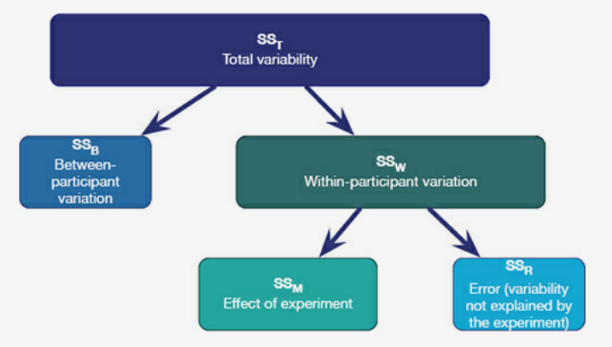
Keeping the stats straight
A repeated measures ANOVA is used to determine if there are statistically significant differences between the means of two or more related groups.
  It should be used when your data has one independent, categorical variable that has two or more levels (or groups) received by all participants and one continuous dependent variable OR one continuous dependent variable assessed at two or more times with all participants being assessed at each time

Slide 7
Mixed design ANOVA
Combines the benefits of the factorial ANOVA and the repeated measures ANOVA
A mixed design ANOVA is used to determine if there are statistically significant differences between the means of two or more groups, with at least one set of related groups and at least one set of unrelated groups
  It should be used when you data has at least one between-subjects IV and at least one within-subjects IV and a continuous DV
  It allows us to look for main effects and interactions

Slide 8
An example
In the simplest 2 x 2 design you would have subjects randomly assigned to one of two groups, but each group would experience 2 conditions (measurements)
 | Anxiety- Before | Anxiety- After
Progressive Muscle Relaxation | Subject 1 Subject 2 Subject 3 Subject 4 Subject 5 | Subject 1 Subject 2 Subject 3 Subject 4 Subject 5
Exercise | Subject 6 Subject 7 Subject 8 Subject 9 Subject 10 | Subject 6 Subject 7 Subject 8 Subject 9 Subject 10

Slide 9
An example
Let’s assume we are interested in levels of self-esteem after performing a scene in a play
Based on the table below
  What is the between-group IV?
  What is the within-subjects IV?
  What is our DV?
 | Scene 1 | Scene 2 | Scene 3 | Scene 4 | Scene 5 | Scene 6
Praise
No Praise

Slide 10
An example
We want to know if northerners, as compared to southerners, will respond differently to aggression depending on the time of day.
Based on the table below
  What is the between-group IV?
  What is the within-subjects IV?
  What is our DV?
 | Morning | Noon | Evening
North
South

Slide 11
Assumptions
Continuous DV
Linearity requires that the IV linearly affect the DV (the relationship looks like a line without any bends)
Each person gets each condition (for within-subjects IV)
  Some degree of missing data can be estimated
Normally distributed residuals requires that the error (or unique variance) has a normal distribution (a bell curve or a normal curve)
Homogeneity of variance requires that each group have similar amounts of variance (the difference between each person’s score and the group average)
Sphericity requires that the relationship between pairs of experimental conditions is similar (i.e., the level of dependence between experimental conditions is roughly equal)

Slide 12
In-class demonstration

Slide 13
Example
We examined whether sexualized women, but not sexualized men, are recognized in the same way as objects are. ... If sexualized women are viewed as objects and sexualized men are viewed as persons, then sexualized female bodies will be recognized equally well when inverted as when upright (object-like recognition), whereas sexualized male bodies will be recognized better when upright than when inverted (person-like recognition).
This is a 2 (stimuli position) x 2 (stimuli gender) x 2 (participant sex) ANOVA
Variables:
  IV between-group: participant sex
  IV within-subject: stimuli position (inverted/upright), stimuli gender (woman/man)
  DVs: percent of correctly identified stimuli (inverted woman, upright woman, inverted man, upright man)
Hypothesis: There will not be significant differences between inverted and upright female bodies. There will be a significant difference between inverted and upright male bodies. ← This is a significant interaction effect
Bernard, P., Gervais, S. J., Allen, J., Campomizzi, S., & Klein, O. (2012). Integrating sexual objectification with object versus person recognition: The sexualized-body-inversion hypothesis. Psychological Science, 23(5), 469-471. doi:10.1177/0956797611434748

Slide 14
How to complete a mixed design ANOVA in JASP
Open data (Sex Objectification.csv)
How to test whether there are significant differences
  Click on ANOVA
  Click on Repeated Measures ANOVA
  Change RM Factor 1 to Stimuli Gender
    Change Level 1 to Woman
    Change Level 2 to Man
  Change RM Factor 2 to Stimuli Position
    Change Level 1 to Inverted
    Change Level 2 to Upright
  Move the DVs into Repeated Measures Cells (make sure they match the labels)
  Move Sex into Between Subject Factor

Slide 15
How to complete a mixed design ANOVA in JASP
How to test if the assumption of sphericity has been violated
  Click Sphericity tests
  If the assumption of sphericity has been violated, click Sphericity corrections and then click the appropriate correction
How to test which groups are different for main effects ← If your F-test wasn’t significant, don’t do this step
  Click Post Hoc tests
  Move the significant effects into the box at the right
  Click Simple Main Effects
  Move Stimuli Position into Simple Effect Factor
  Move Stimuli Gender into Moderator Factor
Compare means for groups which are significantly different for interaction effects ← If your F-rest wasn’t significant, don’t do this step
  Click Additional Options
  Move significant effects into the box on the right

Slide 16
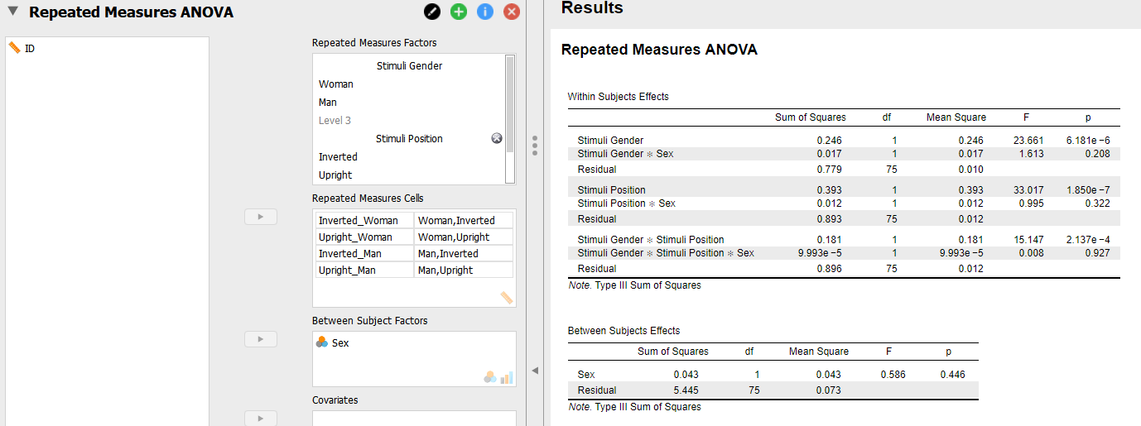
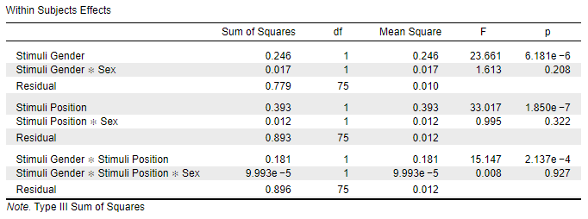
How to test whether there are significant differences

Slide 17
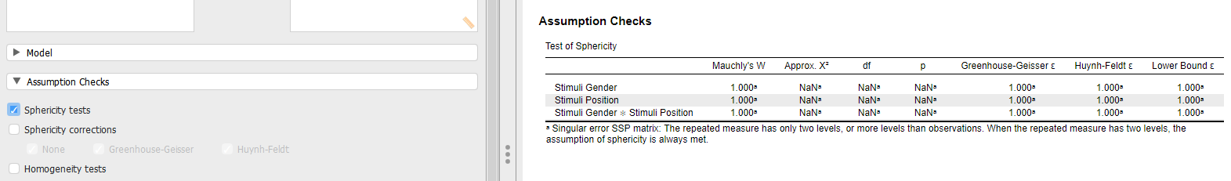
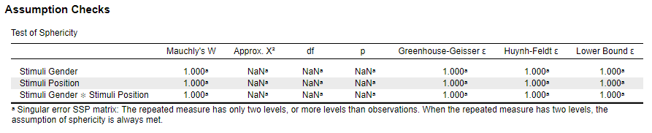
How to test if the assumption of sphericity has been violated

Slide 18
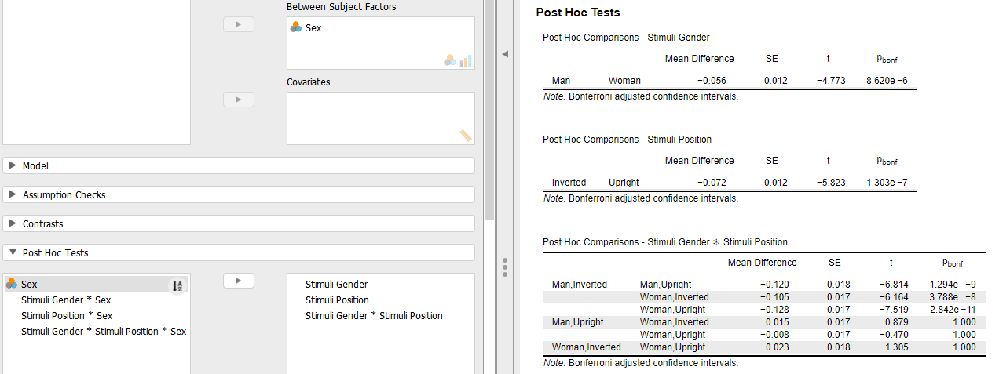
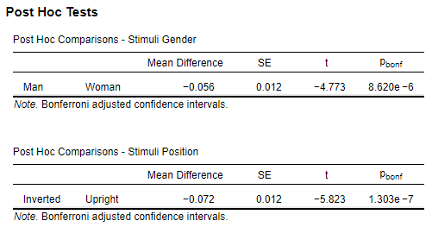
How to test which groups are different

Slide 19
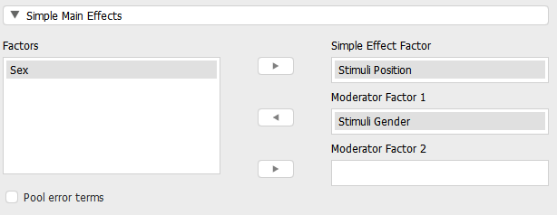
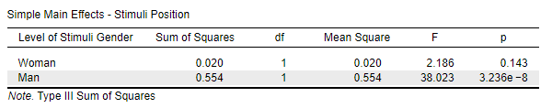
How to test which groups are different

Slide 20
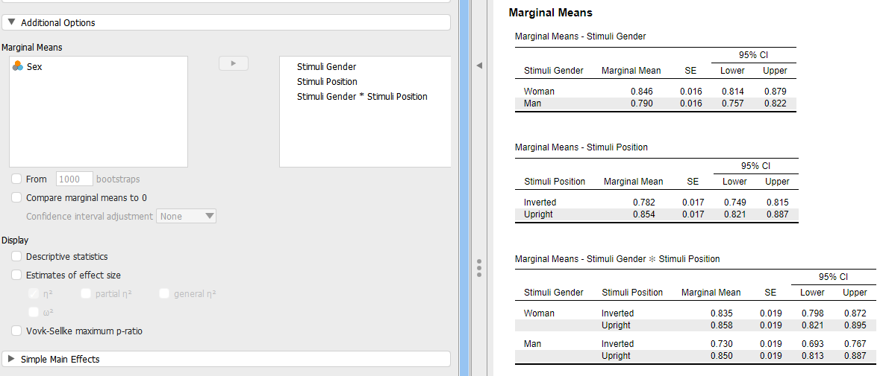
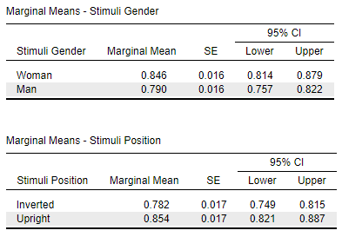
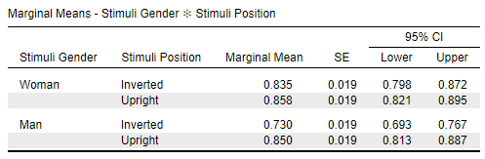
Compare means for groups which are significantly different

Slide 21
How to report results for a mixed design ANOVA
There was a significant main effect of stimuli gender, F(1, 75) = 23.66, p < .001. Post hoc tests revealed that participants correctly identified women stimuli (M = .79, SE = .02) significantly more often than men stimuli (M = .85, SE = .02), t(75) = -4.77, p < .001.
There was a significant main effect of stimuli position, F(1, 75) = 33.02, p < .001. Post hoc tests revealed that participants correctly identified upright stimuli (M = .85, SE = .02) significantly more often than inverted stimuli (M = .78, SE = .02), t(75) = - 5.82, p < .001.
There was a significant interaction effect of stimuli gender and stimuli position, F(1, 75) = 15.15, p < .001. Simple main effects analysis showed that there was not a significant difference in the percent of correctly identified upright and inverted stimuli for women, F(1, 77) = 2.19, p = .14. Simple main effects analysis showed that participants correctly identified upright men stimuli significantly more often than inverted men stimuli, F(1.77) = 38.02, p < .001.

Slide 22
In-class assignment

Slide 23
In-class assignment
Get you data
Calculate a 2x3 factorial ANOVA
Submit screenshots of the results
You do NOT have to report in APA format
Submit the Word document on Blackboard. This is a group assignment, so only one person from the groups needs to submit the document.

